Slide 1

Streamlining Observation Care: Leveraging Data for Improved Patient Management
By:
Jairo Onate
Jun Ming Li
Mazen Alhaffar

Slide 2
TABLE OF CONTENTS
01
05
06
03
Introduction & Variables Dictionary
Model Evaluation
02
Data Cleaning & Preprocessing
Cost analysis
07
Exploratory data analysis (Eda)
Conclusion & Q&A
04
Data Modeling

Slide 3
INTRODUCTION
The hospital's Observation Unit (OU) at Montanaro is struggling with inefficient patient flow and resource utilization.
The goal is to develop a data-driven, predictive model to optimize the exclusion list, improve patient placement decisions, reduce the rate of patients "flipping" to inpatient care, and enhance overall efficiency, ultimately improving patient care and the hospital’s financial performance.

Slide 4
Variables Dictionary
Variable | Description
ObservationRecordKey | Unique identifier for each patient visit
Age | Age of the patient
Gender | Gender of the patient (Male/Female)
PrimaryInsuranceCategory | The patient's primary insurance category (e.g., MEDICAID, MEDICARE, etc.)
InitPatientClassAndFirstPostOUClass | Classification of the patient's status upon admission and after observation
Flipped | Boolean indicator (1 if the patient status was changed to inpatient, 0 if not)
OU_LOS_hrs | Length of stay in the Observation Unit in hours
DRG01 | The primary diagnosis-related group (DRG) code for the patient
BloodPressureUpper | Upper value of the patient's blood pressure
BloodPressureLower | Lower value of the patient's blood pressure
BloodPressureDiff | Difference between upper and lower blood pressure values
Pulse | The patient's pulse rate (beats per minute)
PulseOximetry | The patient's oxygen saturation level (percentage)
Respirations | The patient's respiration rate (breaths per minute)
Temperature | The patient's body temperature in degrees Fahrenheit
DRG Code | Description
428 | Heart failure and shock
599 | Cardiac arrhythmia
786 | Disorders of the nervous system
780 | Acute renal failure and related conditions
428 | Respiratory infections and inflammations
599 | Injuries and poisoning of the musculoskeletal system
111 | Major small and large bowel procedures
820 | Orthopedic conditions

Slide 5
Summary Statistics
Metric | Mean | Standard Deviation | Min | 25th Percentile | 50th Percentile (Median) | 75th Percentile | Max
Age | 69.03 | 18.43 | 19 | 57 | 73 | 86 | 89
OU_LOS_hrs | 62.25 | 51.04 | 1.2 | 24.4 | 45.8 | 84.4 | 405.5
BloodPressureUpper | 139.25 | 25.39 | 80 | 120 | 136 | 155 | 229
BloodPressureLower | 75.27 | 15.19 | 0 | 65 | 74 | 85 | 146
BloodPressureDiff | 63.35 | 20.16 | 3 | 49 | 61 | 76 | 136
Pulse | 79.95 | 16.13 | 37 | 68 | 79 | 90 | 148
PulseOximetry | 96.63 | 2.66 | 75 | 95 | 97 | 99 | 100
Respirations | 17.63 | 3.92 | 8 | 16 | 18 | 19 | 73
Temperature | 97.98 | 1.02 | 94.7 | 97.3 | 97.9 | 98.4 | 103.7

Slide 6
Summary Statistics
The Length of Stay: has a mean of 62.25 hours but with a high standard deviation of 51.04 hours, indicating a large variation in how long patients stay in the observation unit, spanning from a minimum of 1.2 hours to a maximum of 405.5 hours.
Blood Pressure Upper: has a mean of 139.25 mmHg, with a standard deviation of 25.39 mmHg, showing a significant variation in the upper blood pressure values.
Blood Pressure Lower: has a mean of 75.27 mmHg, with a standard deviation of 15.19 mmHg, indicating moderate variation.
Blood Pressure Difference: has a mean of 63.35 mmHg and a standard deviation of 20.16 mmHg, showing that there is moderate variability in the gap between the upper and lower blood pressure readings.
Age: The interquartile range (25th and 75th percentiles) shows that most patients fall between 57 and 86 years of age, and the mean age of patients is 69 years.
Respiration Rate: the mean is 17.63 breaths per minute, which is low compared to the other variables, ranging from 8 breaths per minute to 73 breaths per minute.
Temperature: The mean body temperature of patients is 97.98°F, with a minimum of 94.7°F and a maximum of 103.7°F.

Slide 7

Data Cleaning & Preprocessing
Observe the distribution of data.
Remove outlier.
Scale the data.
Partition and Balance data sets.
Find and replace missing values.

Slide 8
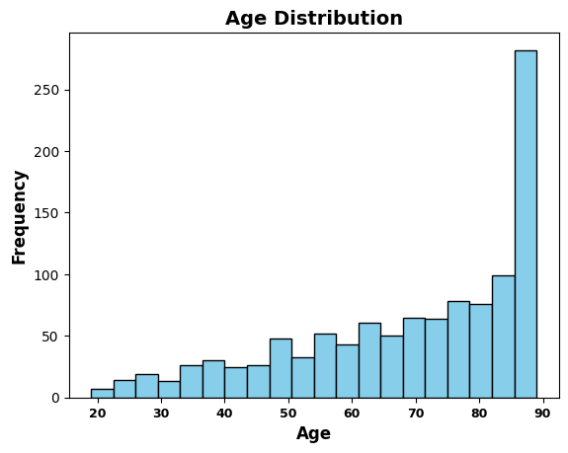
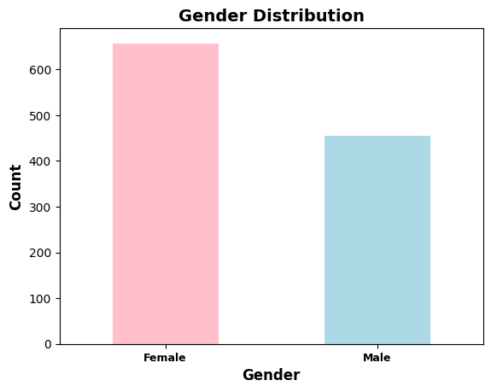
Exploratory data analysis (Eda)
Age distribution is skewed to the right, with most patients being elderly.
Higher count of female patients compared to male patients in the dataset.

Slide 9
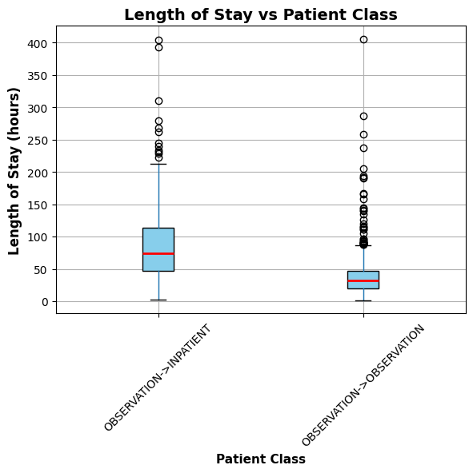
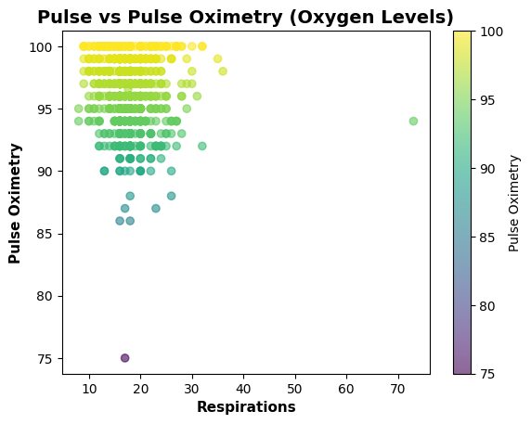
Exploratory data analysis (Eda)
Most patients tend to have high oxygen saturation levels (close to 95-100%), regardless of their respiratory rate. However, there is a slight tendency for pulse oximetry to decrease as respirations increase, particularly for patients with lower oxygen levels.
Patients who flipped to inpatient status have a significantly longer length of stay (with many outliers) compared to the patients who stayed in the observation unit, who generally have a shorter and more consistent length of stay.

Slide 10
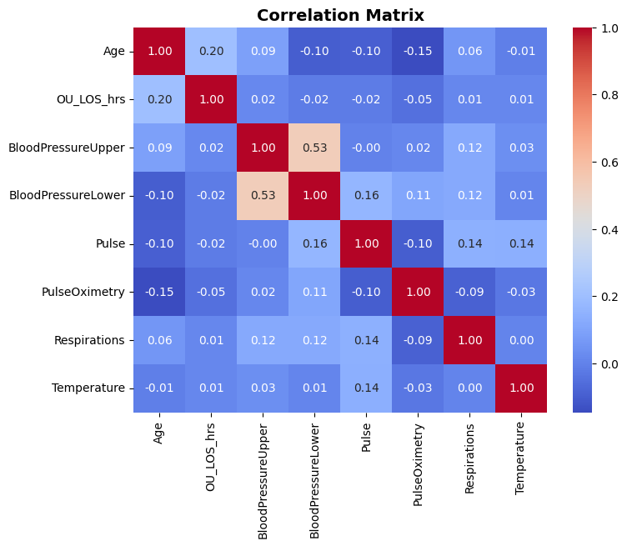
Exploratory data analysis (Eda)
Blood Pressure Lower moderately correlates with Blood Pressure Upper (0.53).
Gender, DRG01, and Primary Insurance Category show minimal correlation with other variables, suggesting independent predictive value.

Slide 11
Data modeling – random forest
Four Models Created
mtry = 3 used as a baseline
Sensitivity helps find at-risk patients
Specificity reduces false positives for better hospital planning
Model | AUC | Accuracy | Sensitivity | Specificity
mtry = 3 | 0.6034 | 0.6031 | 0.5964 | 0.6104
mtry = 4 | 0.6192 | 0.6188 | 0.6084 | 0.6299
mtry = 5 | 0.6101 | 0.6094 | 0.5904 | 0.6299
mtry = 6 | 0.6032 | 0.6031 | 0.6024 | 0.6039

Slide 12
Data modeling – logistic regression
Three Models Created
Variable Selection
Compared: Accuracy, AUC, Sensitivity, & Specificity
Our Choice
Model | AUC | Accuracy | Sensitivity | Specificity
Logistics (11 vars.) | 0.6371 | 0.6188 | 0.6145 | 0.6234
Forward (5 vars.) | 0.6433 | 0.6 | 0.6024 | 0.5974
Final (4 vars.) | 0.6547 | 0.6156 | 0.5904 | 0.6429

Slide 13
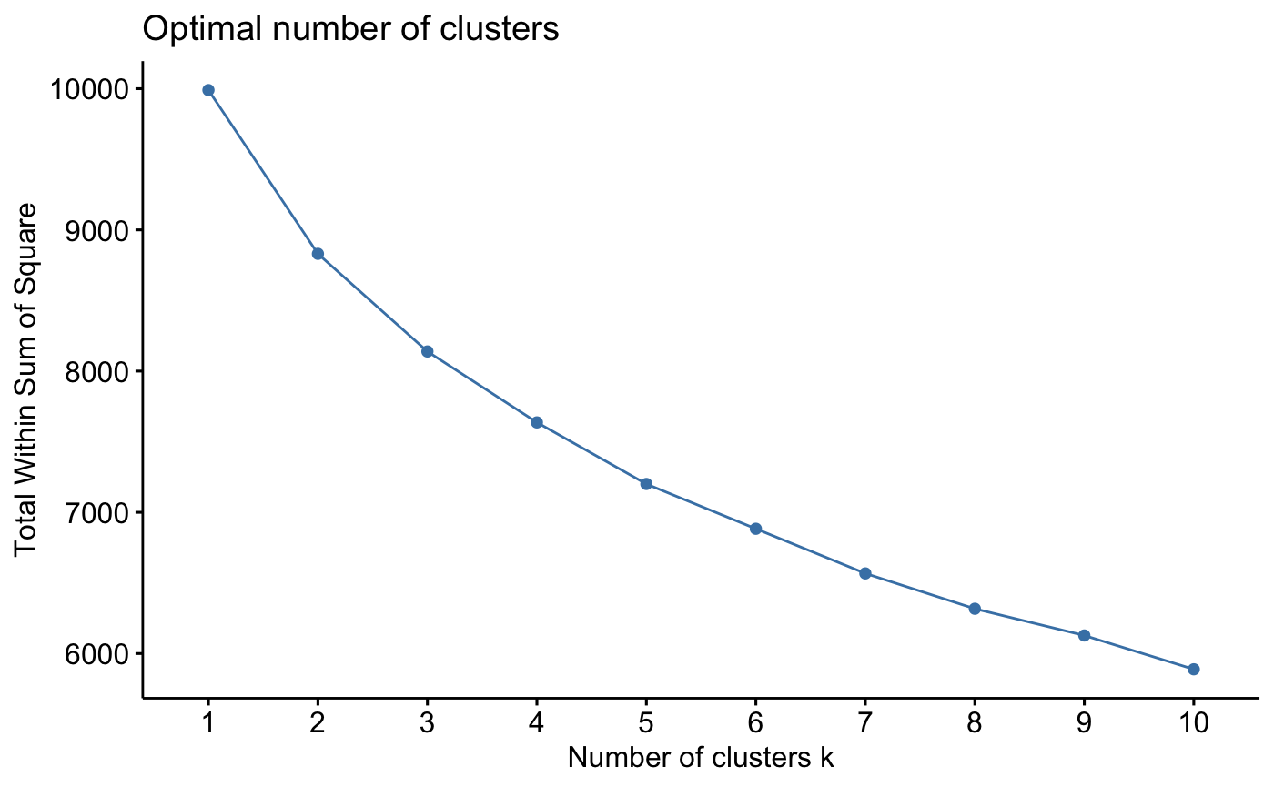
Data modeling – cluster analysis
Numerical variables only
Euclidean distance
Elbow method suggests 4 clusters as optimal number of clusters

Slide 14
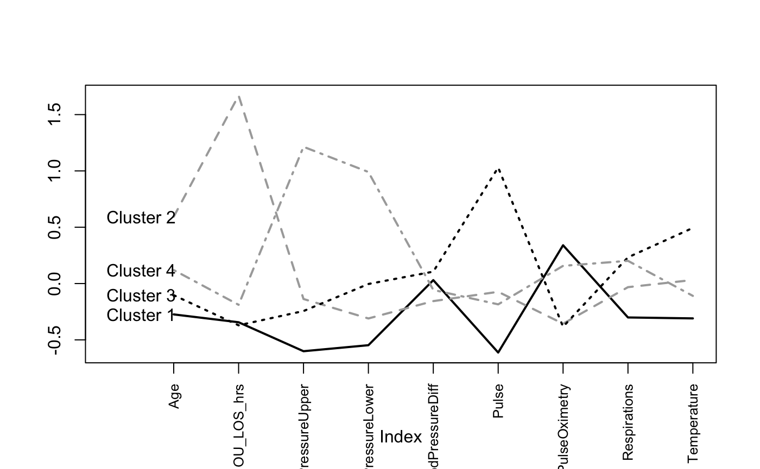
cluster analysis evaluation
Cluster 1: It has relatively low values across most variables, with the lowest values in Age and hours of stay in OU. This cluster possibly represents patients that are creating the bottleneck at the OU since most of their readings are normal.
Cluster 2: This cluster shows high values in Age and longer stays in OU, and overall normal readings in all other aspects. This suggests that the individuals within this Cluster are those that may be part of the true subset of individuals that belong in the OU and do not flip. Moreover, this group may contribute to the congestion in the OU unit, thus the demographic of this cluster is significant to review.
Cluster 3: It is characterized by higher values in Blood Pressure readings, the highest pulse and temperature of all patients, and the lowest stays in OU. This cluster likely represents individuals who need to be flipped to inpatient status since they have critical readings.
Cluster 4: This cluster has more varied characteristics but has the highest Blood Pressure readings. The higher pulse and respiration levels might indicate a cluster of individuals with increased activity or stress, as well as potential hypertension, which usually stays at the OU to be observed.

Slide 15
Model evaluation
Model | AUC | Accuracy | Sensitivity | Specificity
Baseline |  | 0.4608
Logistic Regression | 0.6547 | 0.6156 | 0.5904 | 0.6429
Random Forest | 0.6192 | 0.6188 | 0.6084 | 0.6299
Compared to our baseline, our improved logistic and random forest models have significantly improved performance.

Slide 16
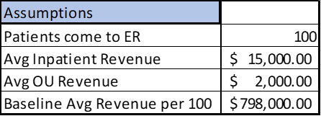
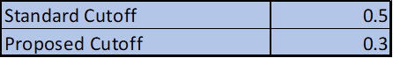
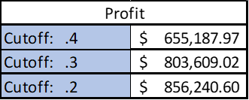
Cost Analysis
Using a cutoff point of 0.5, our model does worse than the baseline.
We must use at least a cutoff of at least 0.3 and below to generate more revenue.
Using 0.1 would mean that all patients are admitted to Inpatient.

Slide 17
SIMULATION
Increasing OU utilization from 13.5 to 22 patients per week aligns with cost trends in the matrix, keeping expenses manageable while maximizing revenue potential.
Higher patient throughput leads to economies of scale, reducing cost per patient and significantly improving profit margins as seen in the gradient of the cost matrix.

Slide 18
Conclusions & Recommendations
Random Forest helped to determine the optimal number of variables to choose for analysis.
We recommend using logistic model to improve hospital patient management. For this model, we propose using a cutoff of at least .3 to improve hospital revenue.
Key Variables: Gender, DRG01, PrimaryInsuranceCategory, and BloodPressureLower
Patients in cluster 1 & 2 are the demographics we need to focus on to figure out the possible bottlenecks in the Observation Unit.
Increasing OU utilization to 22 patients per week optimizes revenue while keeping costs within a sustainable range, maximizing profitability.

Slide 19

Thank you!

